Slide 1


Object Oriented Analysis and Design

Slide 2
“The transformation from a set of requirements and vague notions of what is desired to a structured plan of the building and what actions are required to build it is the creative activity of new development”
Ivar Jacobson

Slide 3
“The distinguishing characteristic of industrial strength
software is that it is intensely difficult, if not impossible,
for the individual developer to comprehend all of the
subtleties of its design. Stated in blunt terms, the
complexity of modern software systems exceeds the
human intellectual capacity.”
Grady Booch

Slide 4
Some Software Failures:
In 1992, a woman received an invitation to attend a kindergarten.
The woman was 104 years old.
A supermarket was fined $1000 for having meat around 1 day too
long on February 29, 1988. The computer program responsible for
printing the expiration label did not take into account that 1988 was
a leap year.
In 1995, bugs in the automated luggage system in Denver’s new
International airport caused suitcases to be chewed up. Because of
this the airport opened 16 months late and $3.2 Million over budget.
After 18 months of development, a $200 million system was delivered to
a health insurance company in Wisconsin in 1984. However, the system
did not work correctly. $60 million in overpayments were made by mistake.
It took 3 years to fix.
The C-17 cargo plane by McDonnell Douglas ran $500 million
over budget because of problems with the avionics software.

Slide 5
The Problem
Software is getting more complex
Software development costs are going up
Software development time is getting longer
software maintenance costs are going up
Software errors are getting more frequent
Many of these problems can be addressed by using a
well defined development process.

Slide 6
Development Models
Waterfall
  nothing moves upstream
Iterative or Cyclic
  do it until you get it right

Slide 7
Four phases of Iterative Development
Inception
Transition
Elaboration
Construction

Slide 8
Inception
Develop a vision of the end product
  What will the product do for its users?
  What will customers pay for this function?
  How will the product be developed?
What are the requirements?
  If we build it, they won’t necessarily come!
  How do we know what to build? – use cases!

Slide 9
Elaboration
Use cases are specified in detail
Over-all Architecture is developed
Detailed business plan is developed
Detailed development plan is developed
Contract made

Slide 10
Construction
Product is developed
End product must satisfy the use cases
agreed to with the customer
Code may still contain defects
Beta code made available – test with customers

Slide 11
Transition
From development to shipped code
Rigorous testing and customer use
Delivery system established
Support system established
Maintenance system established

Slide 12
Workflows
Requirements
Analysis
Design
Implementation
Test

Slide 13
Requirements
Gather requirements from users
Put them into a form everyone can understand – Use Cases!!!
Validate requirements with users
Iterate until you have agreement

Slide 14
Analysis
“High Level Design”
  Domain class diagrams
  Sequence diagrams
  State diagrams
Review with customer, development
Iterate until you get agreement

Slide 15
Design
“Low Level Design”
  Refine existing class definitions
  Implementation level classes
  Interfaces developed
    Function prototypes
Review with customer, development
Iterate until you get agreement
Blueprint for development

Slide 16
Implementation
Code
Debug
Unit test
Go back to design if required

Slide 17
Test
Does the system implement the function specified in the use cases?
Is the code defect free?

Slide 18
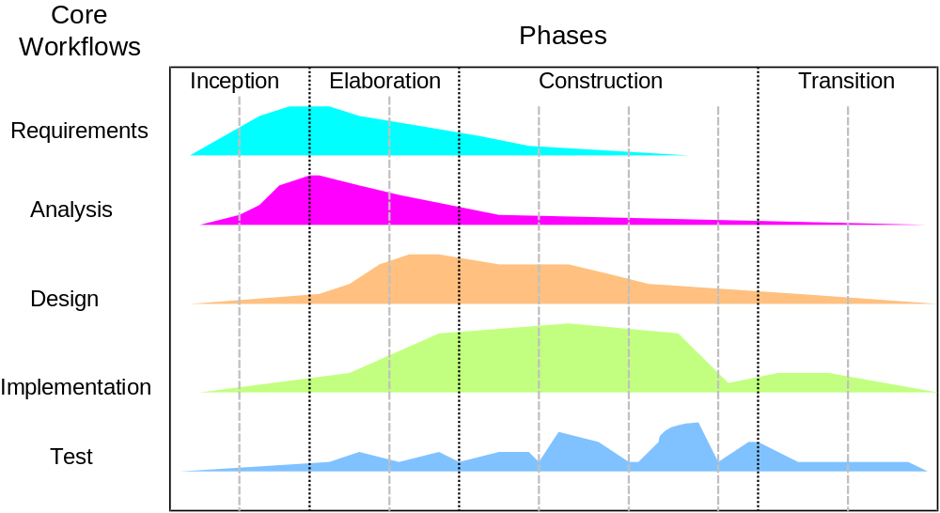
Phases vs. Workflows

Slide 19
Use Cases
A use case specifies a sequence of actions that a system performs, and that yields an observable result of value. The use case is usually initiated by an actor.
An Actor is an external entity that interacts with the system.

Slide 20
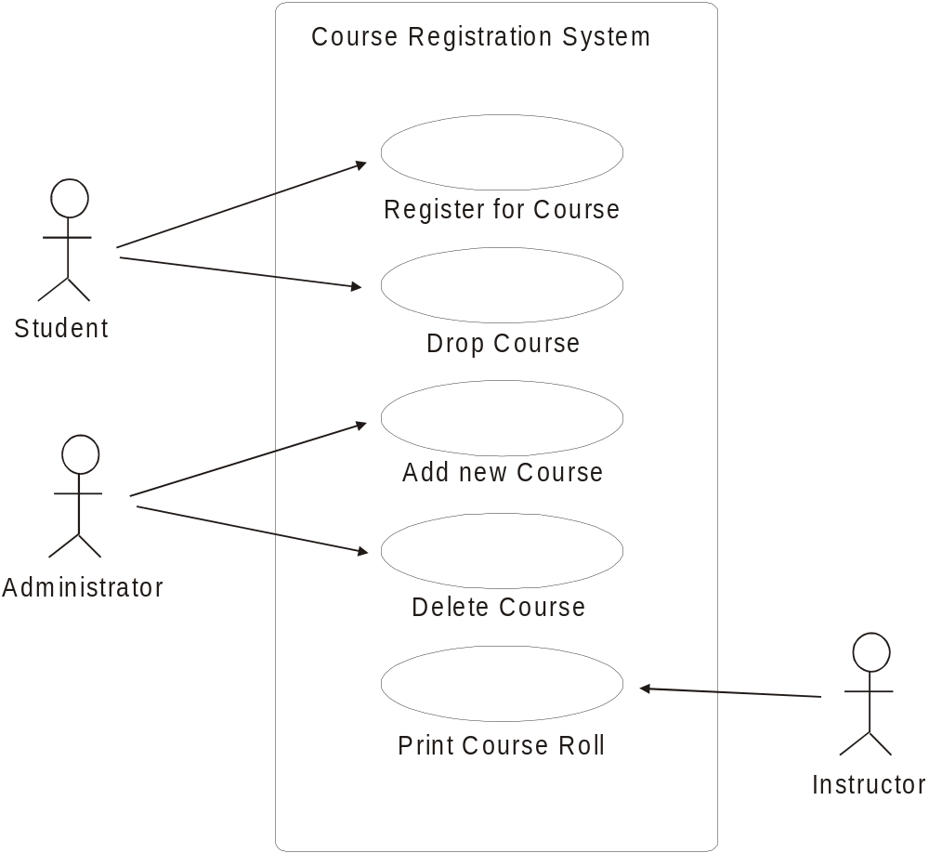
Use Case Diagram

Slide 21
Storyboard
Objective: Fill in details of a use case
Develop a scenario that describes one set of interactions between an actor and the system.
Use a storyboard to lay out the sequence of operations.
Example … Register for a Course

Slide 22
Identify the Objects
Goal: identify the classes and objects that form the vocabulary of the problem domain
Difficult to get it right – takes practice
Look for:
  tangible things
  roles
  places
  events
  devices

Slide 23
Filter
What objects are outside the scope of the problem?
Do some objects refer to the same thing?

Slide 24
CRC Card
Create a CRC card for each class
Class Name
Responsibilities Collaborators

Slide 25
CRC Card
The class’s responsibilities refer to the data that the class is responsible for, and the operations that are provided to manage that data.
Every piece of data must be owned and managed by some class!
Look for strong cohesion in a class. Strong Cohesion means that all class data and functions support the purpose of the class.
Class Name
Responsibilities Collaborators
Student Name
Student Number
Student Address
getName ( )
…

Slide 26
CRC Card
A class’s collaborators are other classes that this class needs to do it’s job. To find collaborators, look for messages sent by this class.
Look for low coupling in domain classes. Low coupling means a class is relatively independent of other classes. Our domain classes will have few or no collaborators.
Class Name
Responsibilities Collaborators

Slide 27
Relationships
Lay CRC cards out on a table.
Do CRC cards satisfy use cases?
Look for message patterns.
  How are objects of this class created?
  Who sends messages to objects of this class?
Can this class be generalized?
Are there composition relationships?

Slide 28
Next steps
Create commented header files for each class using CRC cards
  Describe data elements of the class
  For each operation in the class
    What is it’s purpose
    What parameters does the operation require?
    What values, if any, does the function return?
    Document pre- and post-conditions

Slide 29
UML – From Design to Implementation

Slide 30
Reference Material for this slide presentation
“UML Distilled”

Slide 31
What is UML?
UML stands for Unified Modeling Language.
It is a methodology and a “language” used to
express object oriented analysis and design.
Its strength is in it ability to communicate program
design in a concise, standard notation.

Slide 32
UML is a standard notation, combining the work
of several pioneers in the field of object oriented
design methodology:
Grady Booch
James Rumbaugh
Ivar Jacobsen

Slide 33
UML Tools
Use Case Diagrams
Class Diagrams
Sequence Diagrams
State Diagrams
Activity Diagrams
and more …

Slide 34
Use Case Diagrams
A use case diagram is a way to graphically
represent the set of use cases that have
been created for a system.

Slide 35
Buy Book
Actors carry out use cases. A use
case is some activity that the actor
does using the system.
In a use case diagram, a use case is
shown as an oval with the name of the
activity written inside of the oval.
A use case starts out with an actor.
An actor is a role that a user plays
with respect to the system. For example,
a customer, a clerk, a supervisor, etc.
In a use case diagram, an actor is shown
as a stick figure.
The arrow indicates that this
actor carries out this use case.

Slide 36
A use case diagram shows a group of actors
and related use cases
buy book
order book
customer
check inventory
sales person
Store Manager
add books

Slide 37
Class Diagram
Class Diagrams show the attributes and operations
that belong to a class, and the relationships between
classes.

Slide 38
The class name appears at
the top of the class diagram.
Book
Next we list the attributes or data
members of the class, in the form
visibility name : type = defaultValue
visibility is + (public)
- (private)
# (protected)
- title: string
- author: string
- publisher: string
…
+ Book ( )
+ ~Book( )
+ getTitle ( ): string
+ setTitle (:string): void
…
Finally we list the operations or member
functions of the class, in the form
visibility name (parameterList): return type

Slide 39
Class diagrams can be derived
from CRC cards
Book
- title: string
- author: string
- publisher: string
…
Book
title
author
publisher
…
getTitle( )
setTitle( )
…
+ Book ( )
+ ~Book( )
+ getTitle ( ): string
+ setTitle (:string): void
…

Slide 40
multiplicity
1 one and only one
0..1 zero or one
* zero to any positive number
Associations
Customer
Book
1
*
In this class diagram we note that 1
customer may buy zero or more books.
buy
labels the association

Slide 41
Inheritance
Employee
Inheritance is shown with
an arrow that points from the
derived class to the base class.
A Manager is an Employee.
Manager

Slide 42
Composition
Automobile
Composition is shown with
an diamond going from the
containing class to the
component.
An Automobile has an Engine
Engine

Slide 43
Sequence Diagrams
Class diagrams are static. They do not describe
the over-all flow of control in a program. Sequence
diagrams are useful in visualizing the sequence in
which things happen in a program and how messages
flow from object to object.

Slide 44
Sequence diagram for an ATM Machine
these are objects
. . .
user
display
keypad
reader
account
bank
dispenser
control
display “Swipe Card”
1
swipes
card
getAccount Number
2
display “Enter PIN”
3
enters
pin
getPIN
4
validate
5
getCurrentBalance
6
display “Enter amount to withdraw”
enters
amount
7
getAmount
8
giveCash
9
a message sent to an object
is a call to a function in that
object

Slide 45
display
“Swipe Card”
user
swipes card
display
“Enter PIN”
Bank returns
Balance
ask Bank to
Validate
account
user
Enters PIN
on keypad
display
keypad
reader
account
display “Swipe Card”
display “Enter PIN”
A sequence diagram can be
derived from a storyboard.

Slide 46
State Diagrams
State diagrams have been used for a long time
to describe the behavior or a system. UML state
diagrams are useful in describing all of the possible
states that an object can get into, and what actions
move it from one state to another.

Slide 47
State Diagram for Card Reader in the ATM Example
data received
Sending
Data
Disabled
start
card removed
Waiting
for Card
card sensed
Reading
Card

Slide 48
Activity Diagrams
Activity diagrams are similar to state diagrams,
but they are useful in visualizing the workflow
in a program when the program has many decision
points.

Slide 49
Activity Diagram for Card Reader in the ATM Example
start
Receive
Read Card
Order
Read
Card
Send Data
to Bank
good
read
bad
read
Display
“Swipe Card
Again”
end

Slide 50
From UML to Code
Let’s do the design for a PiggyBank class,
and then see how we move from the design
to code.

Slide 51

What are the attributes of a Piggy Bank?
An object’s attributes will define
the member data of the class.
depending upon the application, some attributes
are more important than others
amount of money
in the bank
color = pink
height = 6”
width = 10”

Slide 52
An object also has behaviors
behaviors will define the member functions of the class
Take money out!
Put money in!
Count the money in the bank

Slide 53
CRC Card
PiggyBank
the key data member
is the amount of money
in the bank.
moneyInBank
putMoneyIn( )
takeMoneyOut( )
countMoney( )
Remember …
responsibilities include
the data that the class
is responsible for and
any functions necessary
to operate on that data.
we’ll ignore
collaborators
for now …

Slide 54
CRC Card
PiggyBank
Class Diagram
moneyInBank
putMoneyIn( )
takeMoneyOut( )
countMoney( )
- : double
+ : void
+ :double
+ :double
+ PiggyBank( )

Slide 55
Class Diagram
PiggyBank
:
-
moneyInBank
double
class
{
private:
putMoneyIn(double)
takeMoneyOut(double)
countMoney( )
void
void
double
+
+
+
:
:
:
;
public:
+
PiggyBank( )
;
;
;
;
};

Slide 56
The code required to implement the functions is
fairly trivial in this case.
putMoneyIn( ) should just add the value of the
parameter to the money in the bank. It does
not return anything.
void putMoneyIn( double money)
{
moneyInBank+=money;
}

Slide 57
Write the test case
Class PiggyBank
{
private:
double moneyInBank;
public:
// purpose: initialize moneyInBank to 0
// parameters: none
// returns: none
// pre-conditions: none
// post-conditions: moneyInBank == 0
PiggyBank( );
void putMoneyInBank( double );
double countMoney ( );
double takeMoneyOut( double );
};
We need a test that creates
a PiggyBank object. The
post condition is that the
value of moneyInBank
should be equal to zero.

Slide 58
Write the test case
Class PiggyBank
{
private:
double moneyInBank;
public:
PiggyBank( );
// purpose: add to moneyInBank
// parameters: the amount to add
// a positive number
// returns: none
// pre-conditions: param is positive
// post-conditions: moneyInBank =
moneyInBank + the parameter
void putMoneyInBank( double );
double countMoney ( );
double takeMoneyOut( double );
};
We need a test that adds various
different amounts to moneyInBank
and checks to see that it handles
valid values correctly

Slide 59
Write the test case
Class PiggyBank
{
private:
double moneyInBank;
public:
PiggyBank( );
void putMoneyInBank( double );
// purpose: return the value of
// moneyInBank
// parameters: none
// returns: a double, moneyInBank
// pre-conditions: none
// post-conditions: none
double countMoney ( );
double takeMoneyOut( double );
};
We need a test that tests various
different amounts of moneyInBank
and checks to see that it handles
valid values correctly

Slide 60
Write the test case
Class PiggyBank
{
private:
double moneyInBank;
public:
PiggyBank( );
void putMoneyInBank( double );
double countMoney ( );
// purpose: subtract from moneyInBank
// parameters: a double – amount to
// subtract
// returns: none
// pre-conditions: the bank has at least
// the amount to be subtracted
// post-conditions: none
double takeMoneyOut( double );
};
We need a test that subtracts various
different amounts from moneyInBank
and checks to see that it handles
valid values correctly

Slide 61
Document your test cases:
Test Case Documentation
Piggy Bank class
Test One: Create a piggy bank using the
default constructor. The resulting object
should have no money in it.
Test Two: Add different amounts of money
to the piggy bank. Try negative values and
zero. Test the value of mineyInBank
after each addition. Test assertions.
Test Three: blah, blah,m blah

Slide 62
Write your test cases:
#include “PiggyBank.h”
#include <iostream>
using namespace std;
int main ( )
{
// Test Case One:
PiggyBank myBank;
cout << “\nWith default constructor”
<< “ money in bank should = 0.
cout << “nMoneyInBank = “
<< myBank.getMoneyInBank( );
// Test Case Two
. . .

Slide 63
Now, you can implement
the class!

